Slide 1

State Space Tunnels
Progress Update
Lawson Fuller July 14, 2021

Slide 2
Presentation Structure
Long Term Goal/Motivation
Present (Short Term) Goal
Results / Progress
Current Obstacles and Possible Solutions

Slide 3
Long Term Goal / Motivation
Data retrieval in a dynamical system through reinstatement (process known as “ecphory” in neuroscience).
Imagine the dynamical system is driven by distinct signals A and B simultaneously.
Auto-associative response: if the system is driven by half of A, then the whole system response to A is reinstated.
Hetero-associative response: connecting separate data (song A + word B) together so that driving the system with just one set of the data (word B) evokes internal dynamics associated with both, leading to immediate reinstatement of dynamical states from past driven response to song A.
Possibly achievable by building system to exhibit “state space tunnels”

Slide 4
Present (Short Term) Goal
Goal: a dynamical system which wanders the state space over a prolonged period of time (seconds) without repeating, or some method that allows shorter repeating patterns to drive longer repeating patterns.
System must by default shut off when not driven, with an exception for a stored trajectory (to allow auto-associativity).

Slide 5
Present (Short Term) Goal
Since neurons are not made to fire on a clock, previous rules for the state space tunnel concept need to be revised (replacement ideas follow later in this presentation).

Slide 6

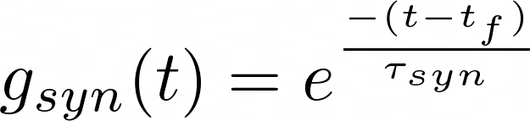
Network

Slide 7
Results / Progress
Since last presentation, fixed more program bugs:
Flawed synaptic contribution to equations of motion
Previously, postsynaptic neurons only responded to the last firing of presynaptic neurons. There was an incorrect response in postsynaptic neurons to rapidly-spiking neurons when time delay is larger than presynaptic interspike interval.

Slide 8
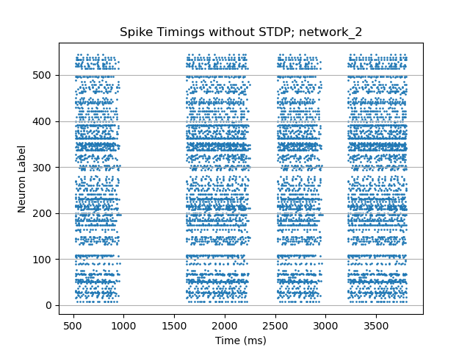
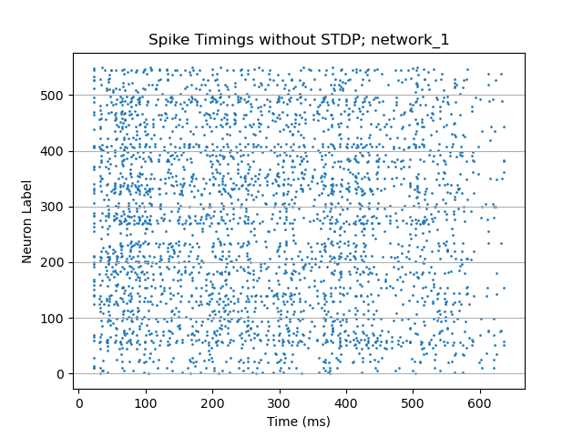
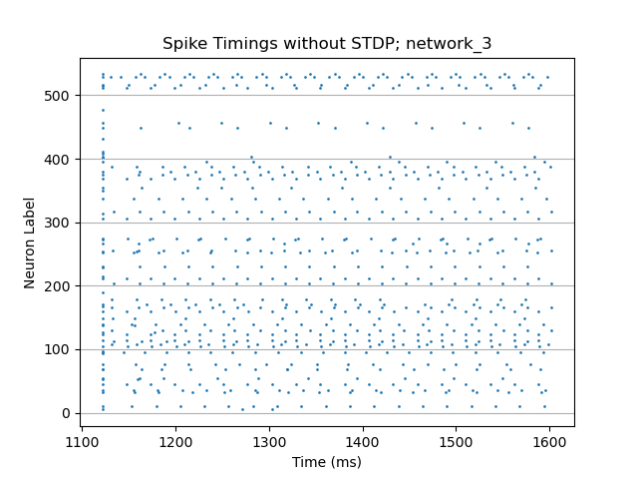
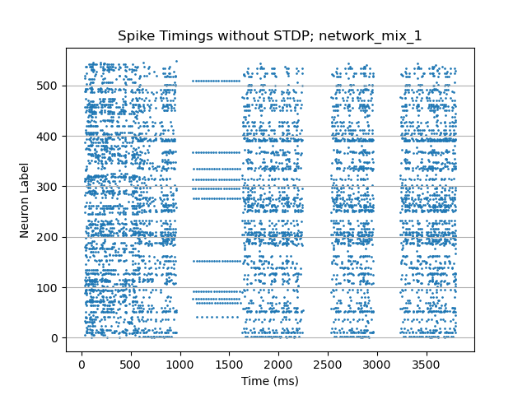
Results / Progress
A lot of new code to easily connect networks together into a larger network, and solve the larger network.
Data 2
Data 1
Data 3
1
2
3
2
2
2

Slide 9
Results / Progress
It is possible for response networks to produce patterns with length 600ms with suitable network parameters (currently difficult for me to know which sets of parameters are “suitable” before testing):

Slide 10
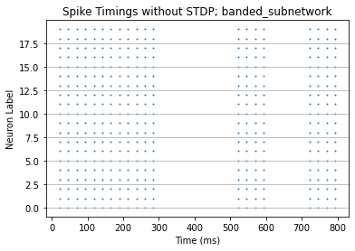
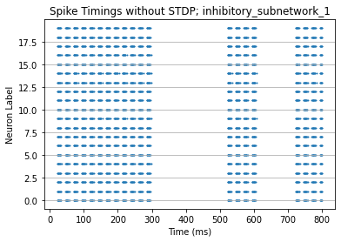
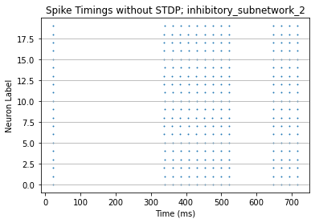
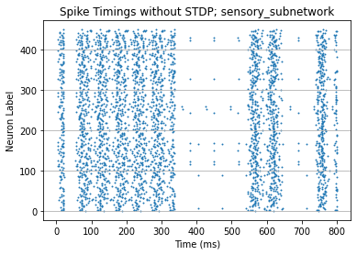
Results / Progress
Data 1 (constant magnitude, on and off)
Excites
Checking that full network results make sense:
Inhibits
Data 2 (constant magnitude, always on)
Inhibits
Data 3 (constant magnitude, on at start)
Data 4 (constant magnitude, on at end)

Slide 11
Discussion of Results / Progress
It took a lot of experimentation to find network configurations that didn’t display clearly periodic responses to static stimuli, as below:
It appears that if excitatory neurons are too densely connected, then we risk all neurons firing and/or activity that persists beyond stimulus (only a good thing for memorized trajectories).

Slide 12
Discussion of Results / Progress
Several experiments here:
In time range (0,2200) I test whether the response to stimulus 2 changes depending on the preceding stimulus. It does.
Comparing the last two columns of activity, we see activity is very closely repeated for the same stimulus.
We also see that (from 1000 to 2200) if the preceding activity (from 3) is very low, then the response to 2 is nearly identical to a well-separated response to 2 (times 2500 to 3000)
These seemingly minor differences in the response to 2 may be important when considering state subspaces
1
2
3
2
2
2

Slide 13
Present Obstacles and Possible Solutions
Allowing two seemingly contradictory things to be true:
A signal will always start the response in the same point of phase space
Previously saved trajectories don’t allow outside states to enter the trajectory, which means the trajectory resulting from a response to only B should be different than the trajectory resulting from a response to A followed by B.
May be solvable by:
Signal starts response in similar subspace of the phase space, not exactly at the same point (see previous slide for illustration)
Saved trajectories are only “shielded” against weak incursions, not strongly driven ones

Slide 14
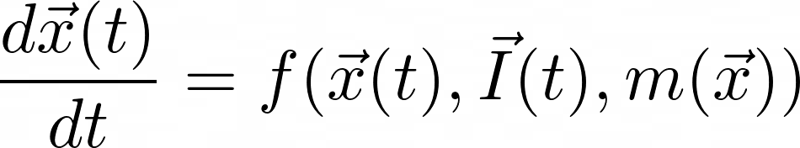
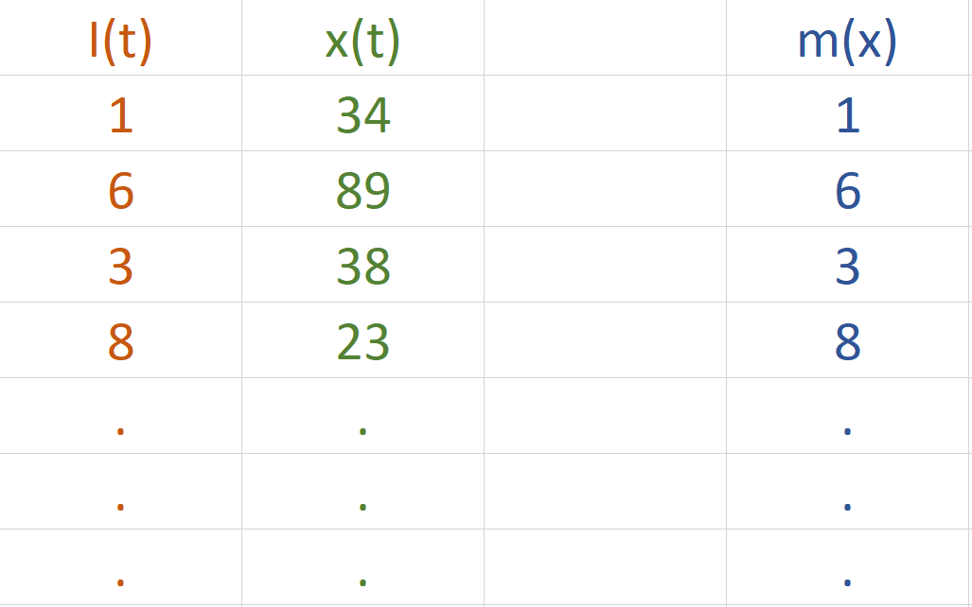
Present Obstacles and Possible Solutions
Rule which allows trajectories to be saved when neurons don’t fire on a clock is unknown, but an idea is:
Network state x(t) driven by I(t) responds with specific trajectory x*(t). If I(t) is removed, network must be able to reinstate x*(t) in order for it to be considered “stored”. It does this by shaping a new function m() that functionally replaces I(t):
m(x) is a function of x because we can imagine:

Slide 15

Present Obstacles and Possible Solutions
Since m is a function of state x, each neuron previously in contact with the stimulus now relies on cues from its connected neighbors to know what state it should take.
This resembles reservoir computing, where .

Slide 16
Present Obstacles and Possible Solutions
Function m(x) doesn’t guarantee that perturbed versions of stored trajectory x*(t) will trend back toward x*(t).
m(x) doesn’t keep very different trajectories from approaching it, or keep nearby trajectories from deviating away. This is why we require the “tunnel” rules. These rules will affect all neurons, not just those in direct contact with the stimulus.
Each neuron should be equipped with spike-timing-dependent-plasticity (STDP) rules that allow them to use the information local to themselves to shape m(x) and (by changing f(x)) state space tunnels

Slide 17
Backup Slides

Slide 18
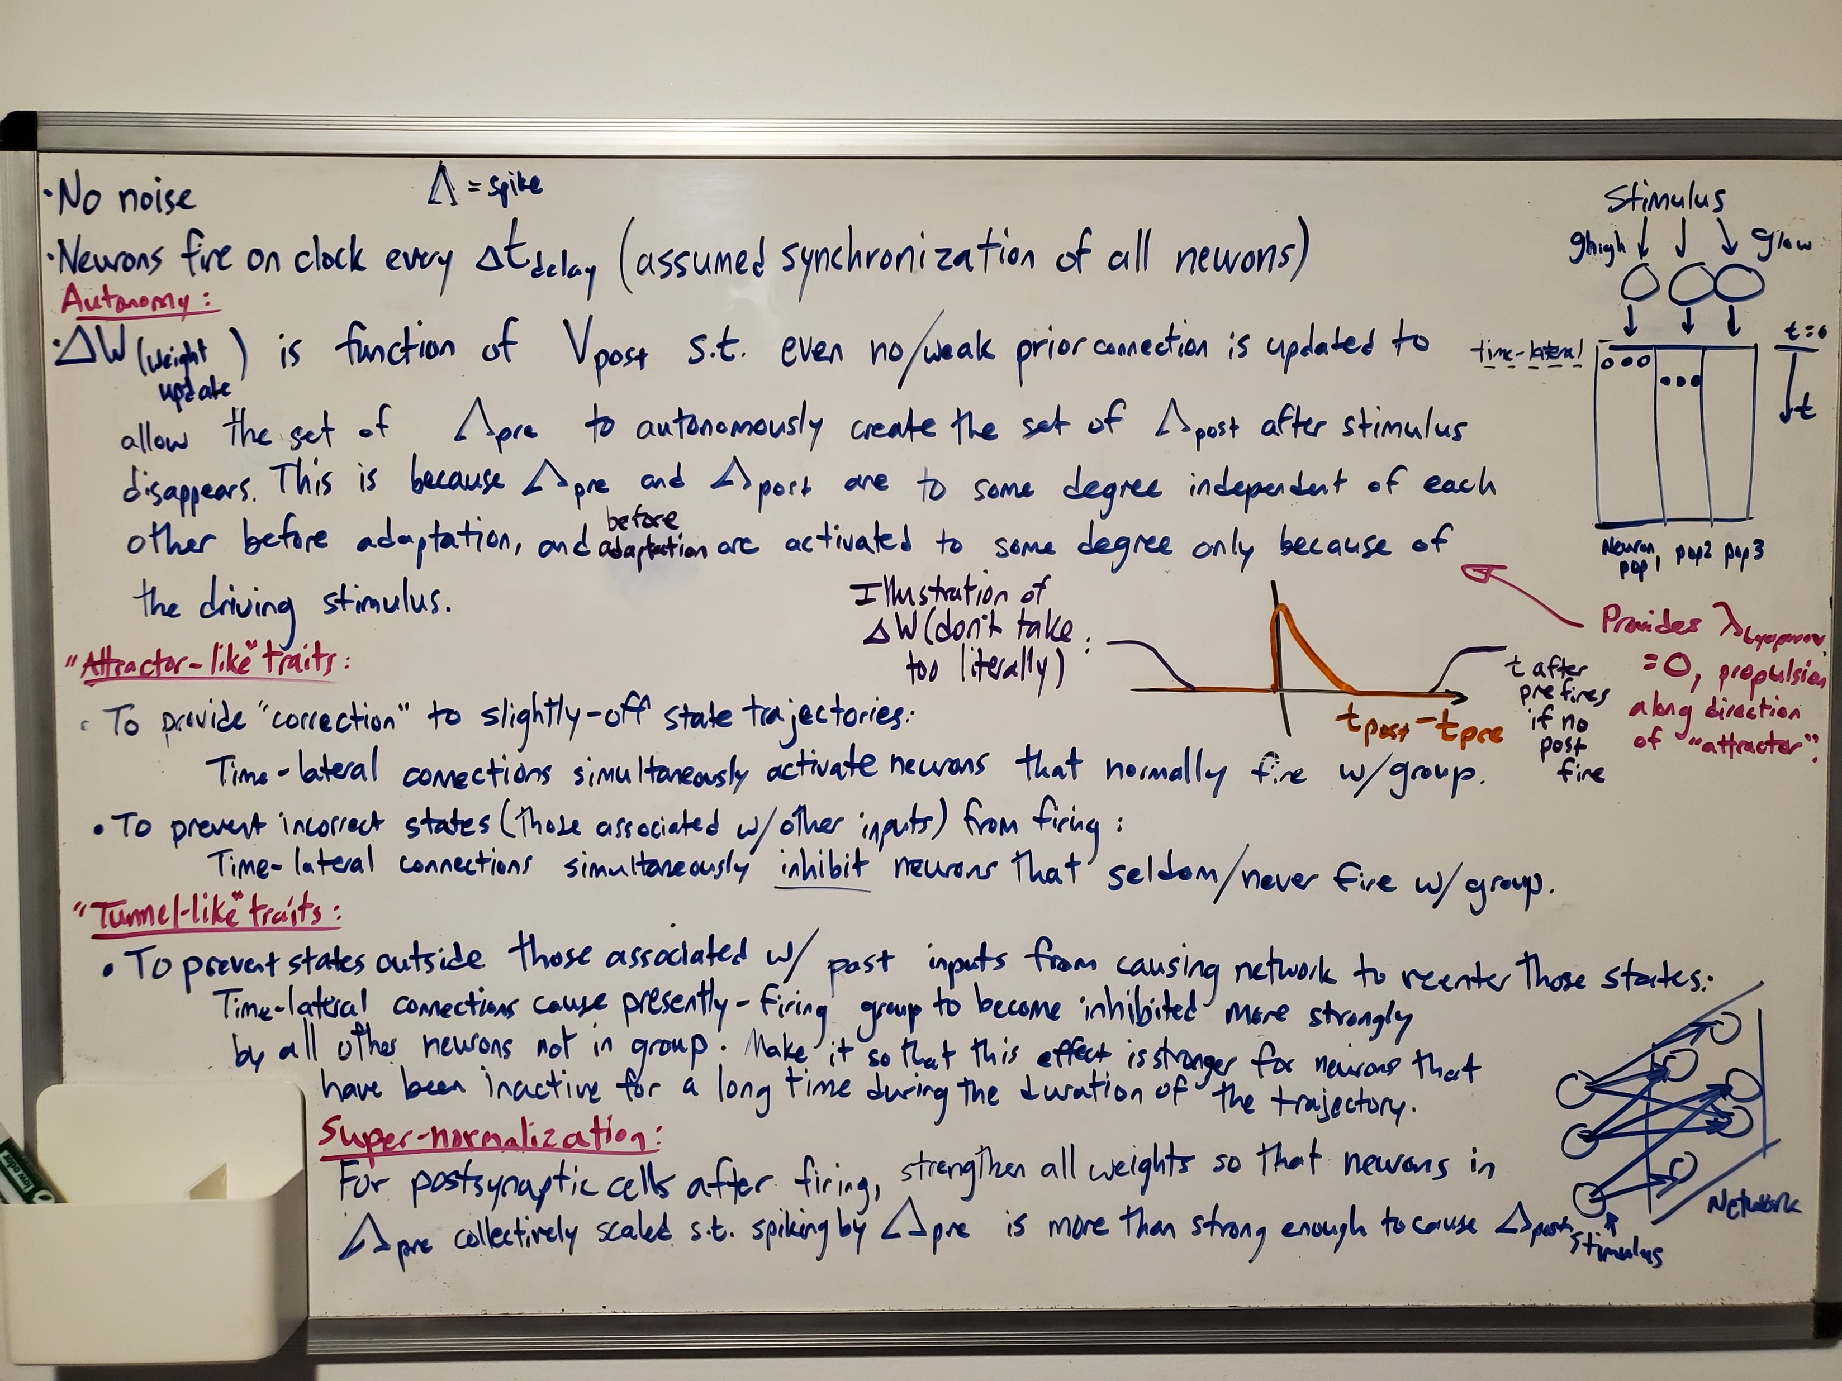
State Space Tunnel Rules

